Slide 1
CSS

Slide 2
What is CSS
CSS (Cascading Style Sheets) is a language used to describe the presentation of a document written in a markup language such as HTML.
While HTML is responsible for the structure and content of a webpage (like headings, paragraphs, and images), CSS controls how these elements look and feel—things like colors, fonts, layouts, and spacing.

Slide 3
Adding CSS to a webpage
There are 3 methods to add CSS in your webpage.
1. Inline CSS <h1 style=”color: red”>This is header</h1>
2. Embedded CSS <style> h1{ color: red } </style>
3. Linked CSS <link href=”./style.css” >

Slide 4
CSS Selectors
Selectors are patterns used to target elements on a webpage that you want to style.
Element Selector
Class Selector
ID Selector
Universal Selector
Attribute Selector
Descendant Selector
Child Selector
Adjacent Sibling Selector
General Sibling Selector
Pseudo-class Selector
Pseudo-element Selector
Group Selector

Slide 5
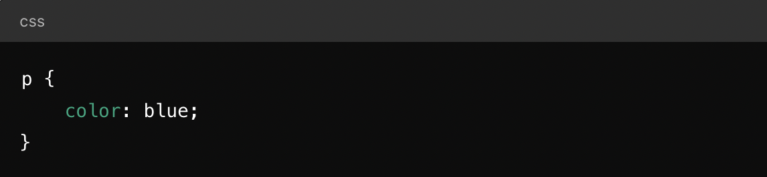
Element Selector
Targets all instances of a specific HTML element.
Example: This rule will set the text color of all <p> elements to blue.

Slide 6
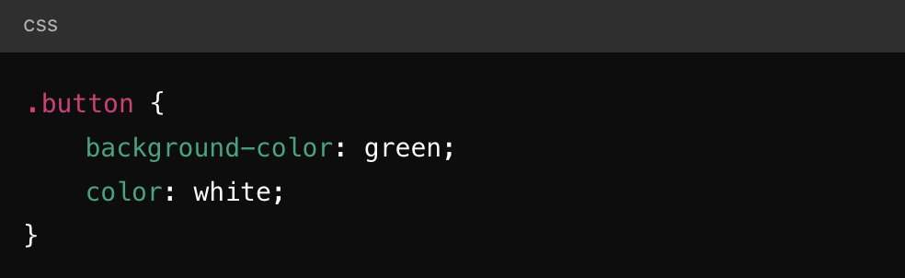
Class Selector
Targets elements that have a specific class attribute.
Example: This will apply the styles to any element with the class button, like <button class="button">Click me</button>.

Slide 7
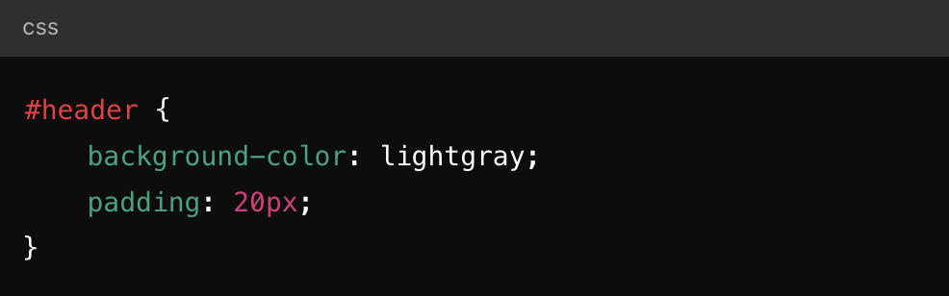
ID Selector
Targets a single element with a specific ID attribute. IDs should be unique within a document.
Example: This will apply styles to the element with the ID header
such as <div id="header">Welcome!</div>.

Slide 8
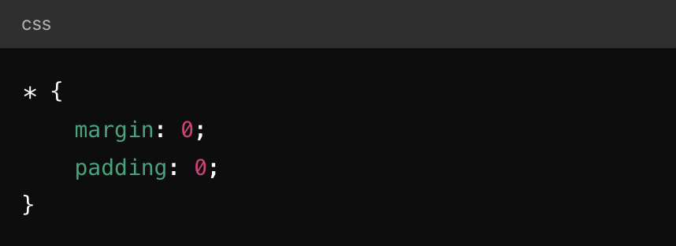
Universal Selector
Targets all elements on the page.
Example: This resets the margin and padding for all elements to 0.

Slide 9
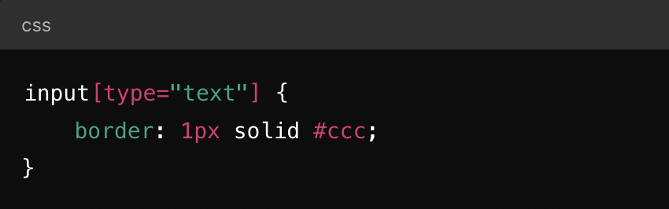
Attribute Selector
Targets elements based on the presence or value of an attribute.
Example: This targets all <input> elements where the type attribute is "text".

Slide 10
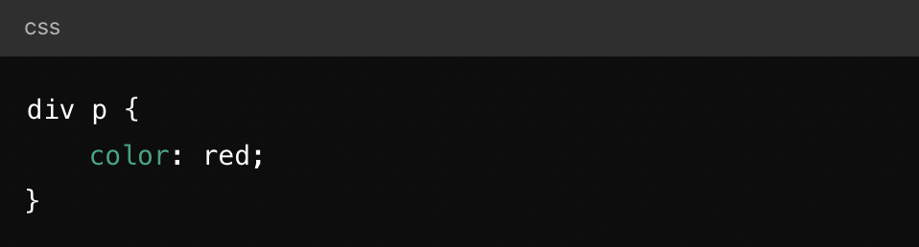
Descendant Selector
Targets elements that are nested within a specified ancestor element.
Example: This will style all <p> elements inside a <div> with red text.

Slide 11
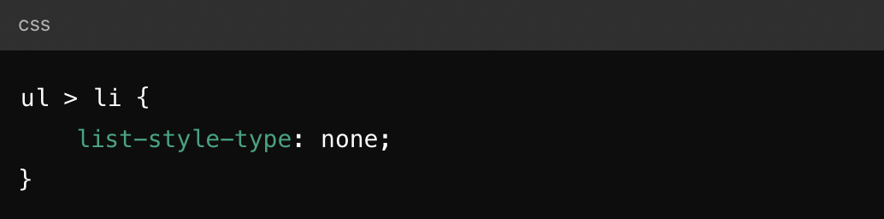
Child Selector
Targets elements that are direct children of a specified parent element.
Example: This will remove the bullet points from all <li> elements that are direct children of a <ul>.

Slide 12
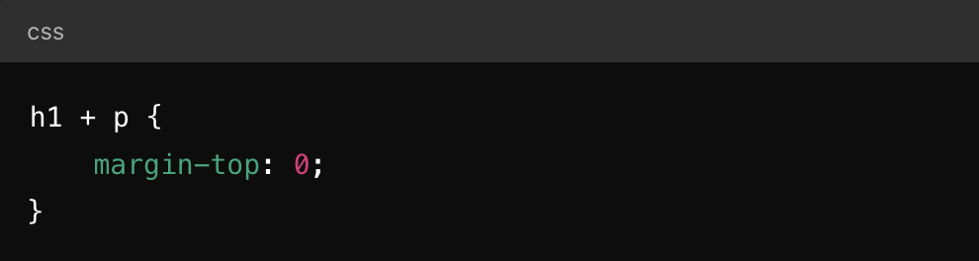
Adjacent Sibling Selector
Targets an element that is immediately following a specified element.
Example: This will remove the top margin from the first <p> element that directly follows an <h1>.

Slide 13
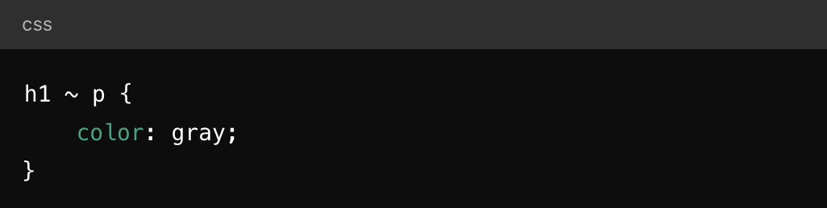
General Sibling Selector
Targets all elements that are siblings of a specified element.
Example: This will turn all <p> elements gray that are siblings (i.e., share the same parent) of an <h1> element.

Slide 14
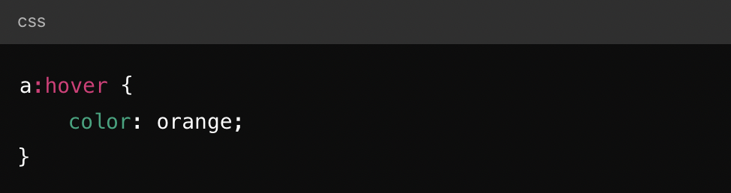
Pseudo-class Selector
Targets elements based on their state or position in the document tree.
Example: This will change the color of a link to orange when the user hovers over it.

Slide 15
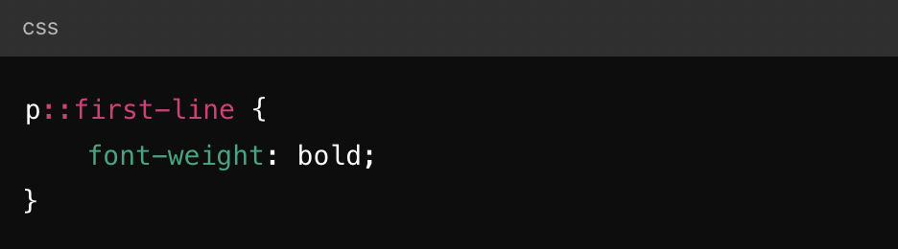
Pseudo-element Selector
Targets specific parts of an element.
Example: This will make the first line of all <p> elements bold.

Slide 16
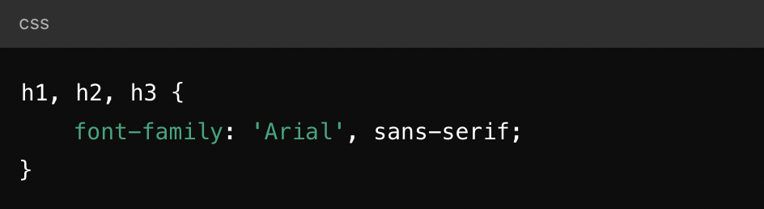
Group Selector
Applies the same styles to multiple elements.
Example: This sets the same font family for all <h1>, <h2>, and <h3> elements.

Slide 17
Cascading
The "cascading" in CSS refers to the way styles are applied in a hierarchy, with rules that are closer to the element (in terms of specificity) taking precedence. For example:
Inline styles (written directly in the HTML tag) will override styles defined in an external stylesheet.
More specific selectors will override less specific ones (e.g., an ID selector will override a class selector).

Slide 18
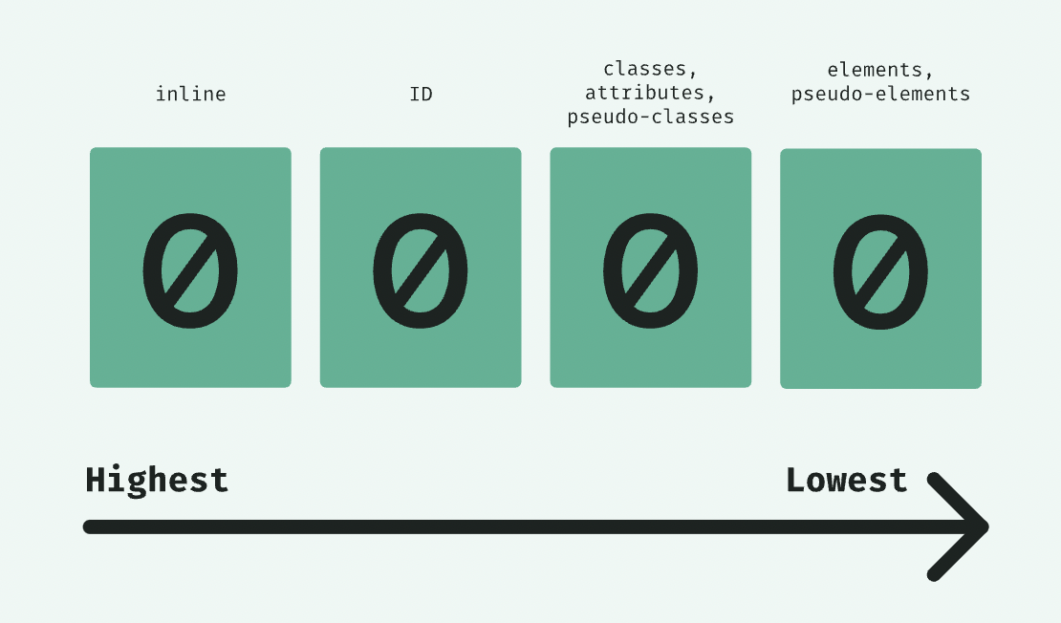
Specificity
Inline styles
IDs
Classes, pseudo-classes, attribute
Element, pseudo-elements

Slide 19
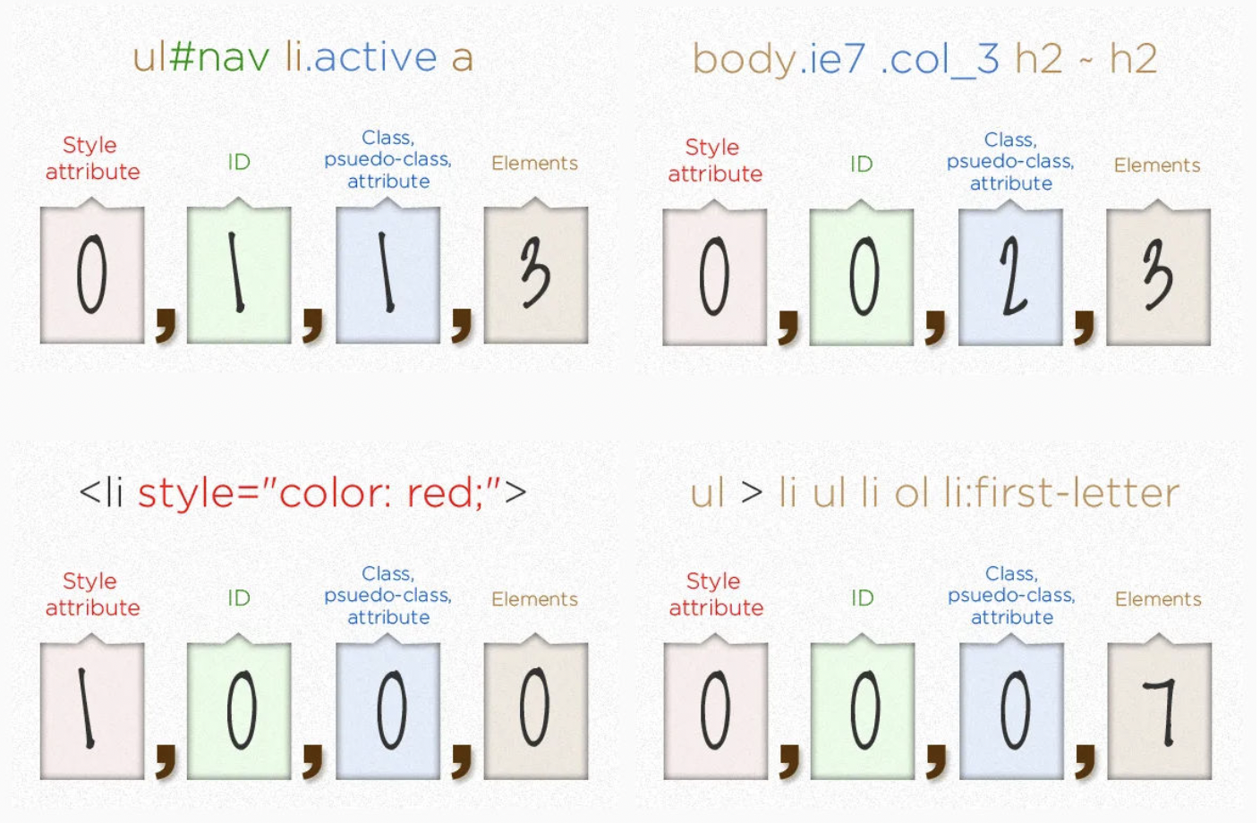
Specificity Examples

Slide 20
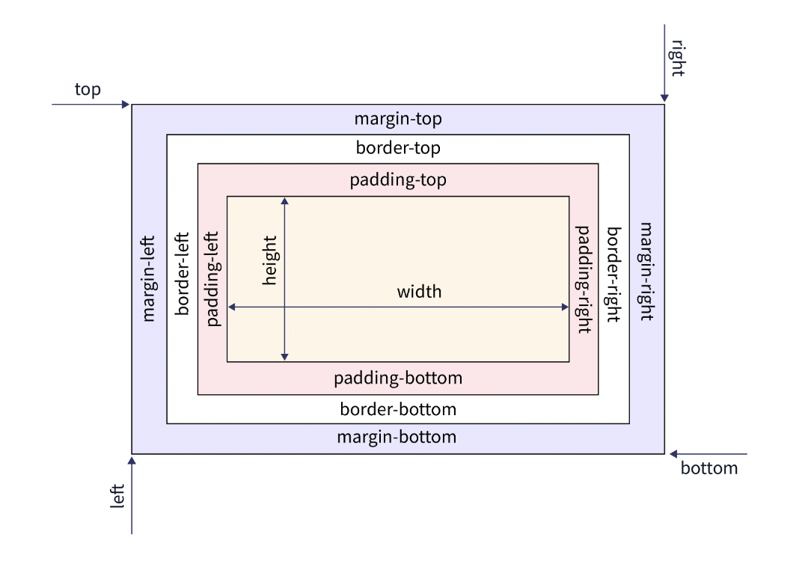
Box Model
Every HTML element on a page is represented as a rectangular box, and the box model defines the size, padding, border, and margin of these boxes. Understanding the box model is crucial for controlling the layout, spacing, and alignment of elements.

Slide 21
Box Sizing
By default, the width and height properties only apply to the content box. However, you can change this behavior using the box-sizing property:
content-box (default): Width and height include only the content, excluding padding and border.
border-box: Width and height include padding and border, but not the margin.

Slide 22
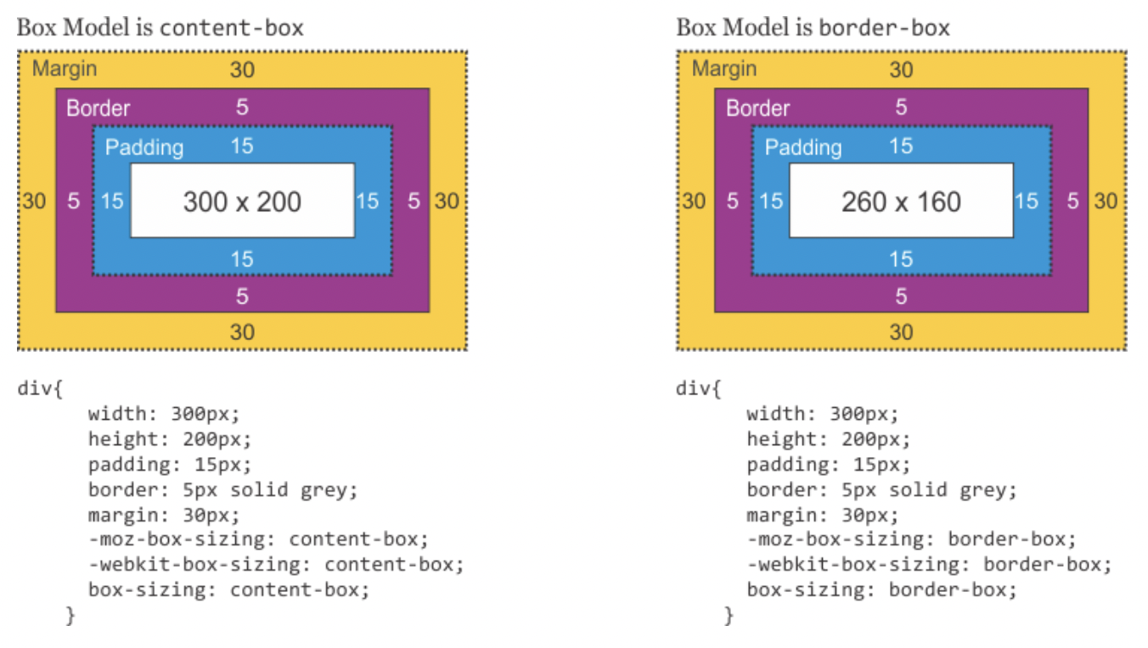
Box Sizing Example
With box-sizing: border-box;
the width and height properties will
include the padding and border,
making it easier to control the size of elements.

Slide 23
Position
The position property in CSS is used to specify how an element is positioned on a webpage. It controls the layout of elements by determining their placement relative to their normal position, containing element, or the viewport.
There are five different position values:
Static
Relative
Absolute
Fixed
Sticky

Slide 24
position: static
This is the default position value for all elements. Elements are positioned according to the normal document flow, meaning they appear where they naturally fall in the HTML.
Elements with position: static; are not affected by top, right, bottom, or left properties.
They stack on top of each other based on the order they appear in the HTML.

Slide 25
position: relative
The element is positioned relative to its normal position. Using the top, right, bottom, or left properties will move the element from where it would normally be, without affecting other elements around it.
Other elements remain in their default positions.
It can be used as a reference point for absolutely positioned child elements.

Slide 26
position: absolute
The element is positioned relative to the nearest positioned ancestor (anything with a position other than static). If there is no positioned ancestor, it will be relative to the initial containing block (often the <html> element).
The element is removed from the normal document flow, so it won’t affect the position of other elements.
You can control its position using the top, right, bottom, and left properties.

Slide 27
position: fixed
The element is positioned relative to the browser window, meaning it stays in the same place even when the page is scrolled.
Like absolute, it’s removed from the document flow.
Often used for navigation bars or other elements that should remain visible while scrolling.

Slide 28
position: sticky
The element is positioned based on the user's scroll position. It behaves like a relative element until it reaches a defined position (like top: 0), after which it behaves like fixed until it leaves the viewport.
Useful for creating elements that stick to the top of the page as you scroll down.
Only works within the parent container’s boundaries.

Slide 29
Hiding Element
display: none
visibility: hidden

Slide 30
CSS background
background-color
background-image
background-repeat
background-size
background-position
background: [background-color] [background-image] [background-position] [background-size] [background-repeat];

Slide 31
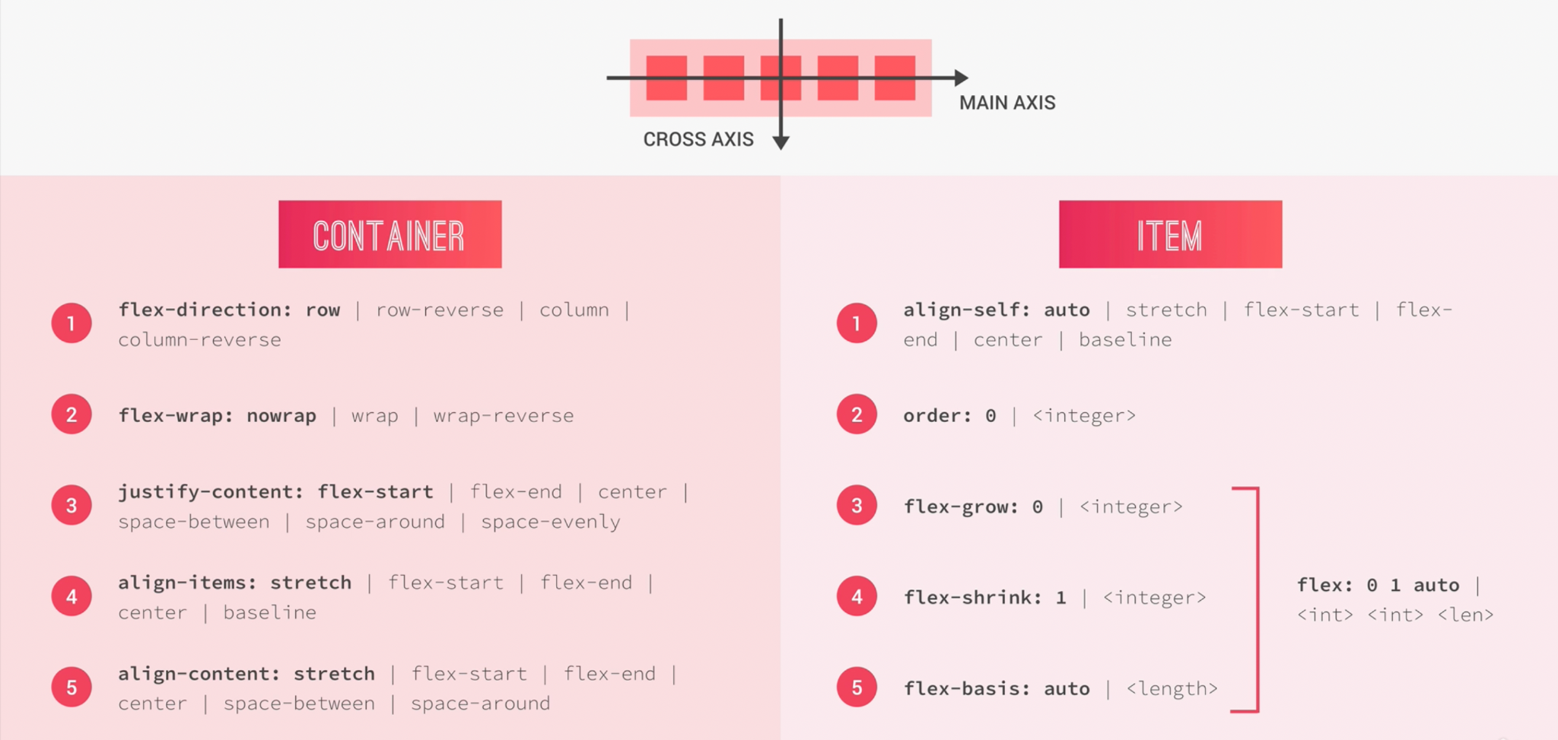
Flexbox
Flexbox is used for creating flexible layouts that can adjust elements' sizes and positions in a container.

Slide 32
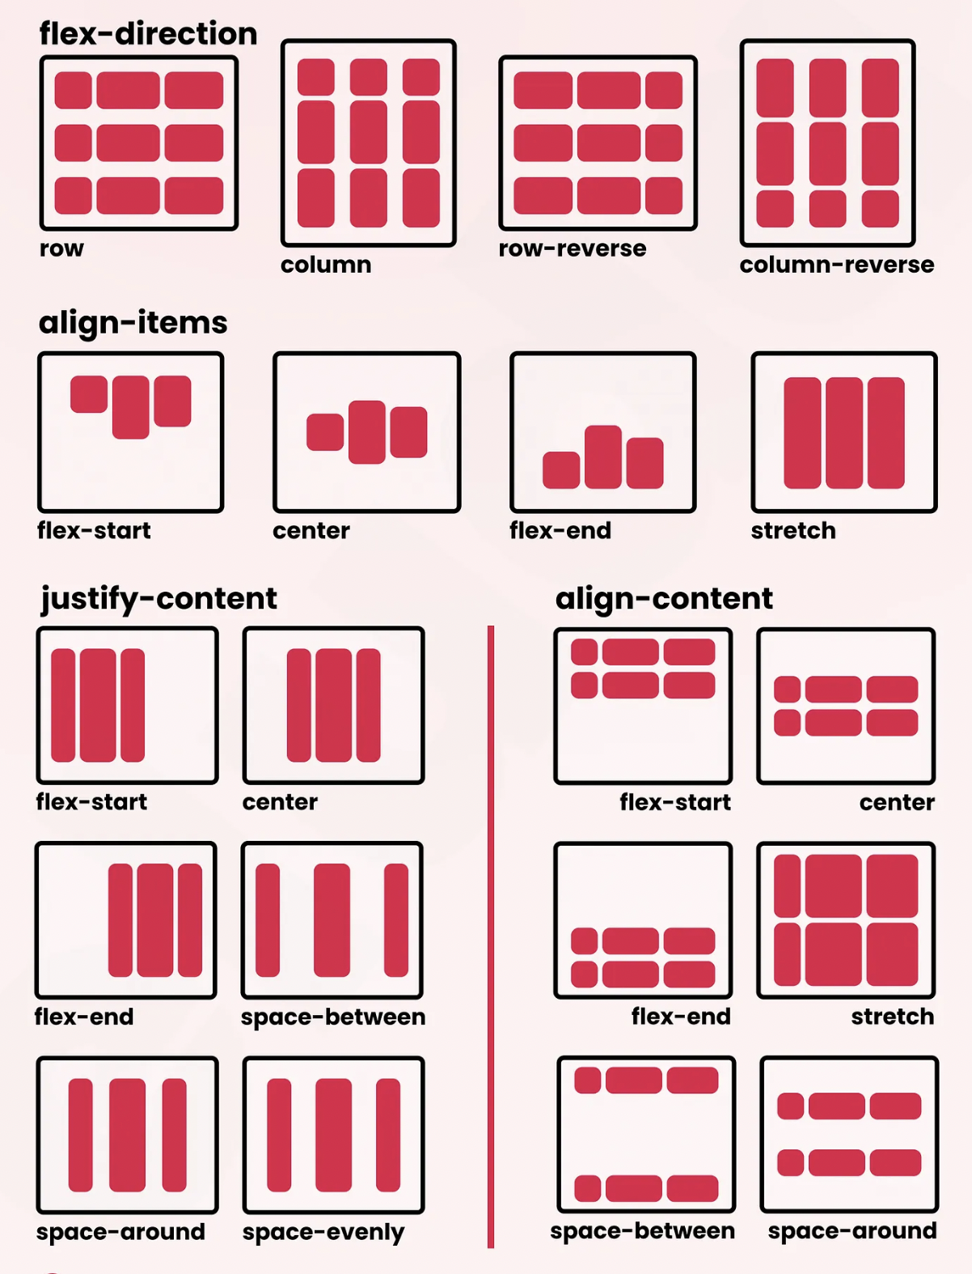
Examples

Slide 33
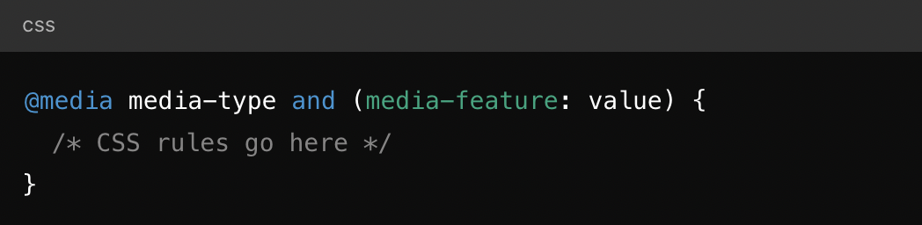
Media Queries
Media Queries is used for creating responsive web designs, allowing your website to adapt its layout and styling to different screen sizes, orientations, and other device characteristics.

Slide 34
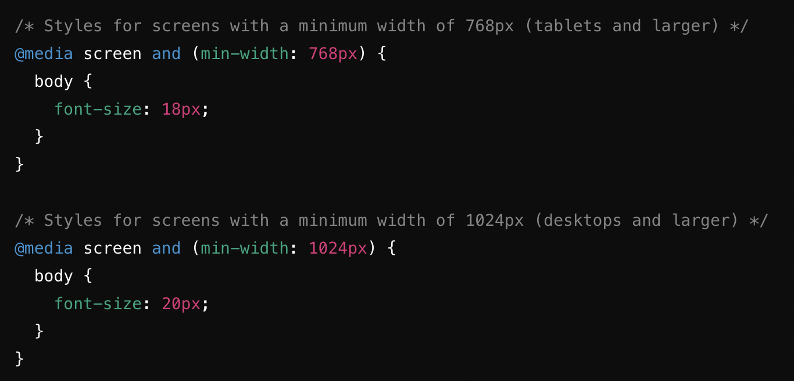
Media Queries
media-type: This defines the type of device (e.g., screen, print, all). The most common type is screen, which applies to computer screens, tablets, and smartphones.
media-feature: These are the conditions being tested, such as screen width, height, or orientation.
value: This is the value you are testing for in the media feature, like a specific width in pixels.

Slide 35
Thank you

